Slide 1
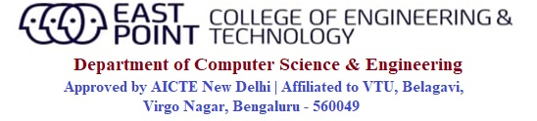
Internship(21INT49) on
EPC Website using HTML & CSS
Presented by, | Under the guidance of, Prof. Divya U H Assistant Professor Department of CSE, EPCET
Rupam Bhattacharyya Usn: 1EP21CS089

Slide 2
CONTENTS:
Introduction
About Industry
Aim and Objectives of the Internship
Hardware and Software Requirements
Internship Implementation
Result and Result Analysis
Conclusion
References

Slide 3
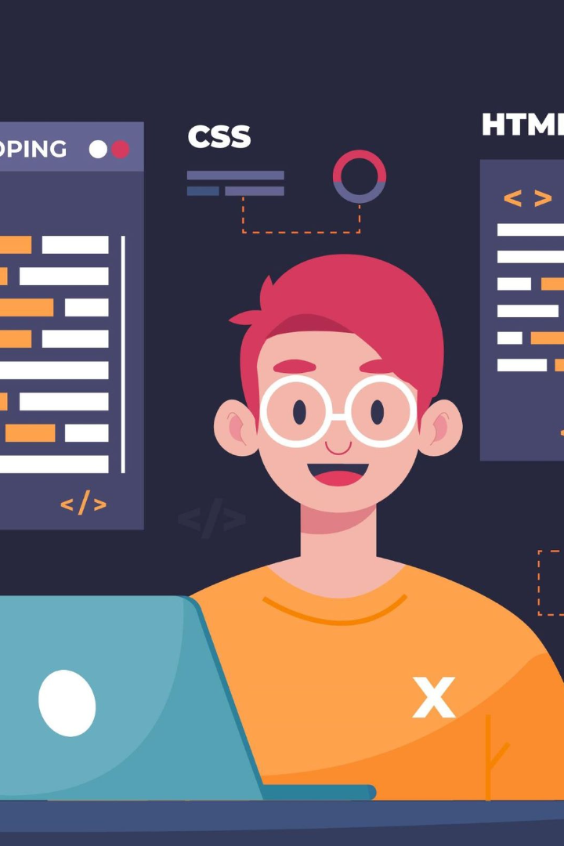
Web Development Using HTML and CSS
Welcome to our presentation on web development using HTML and CSS! In this presentation, we will cover all the basics of HTML and CSS and show you how to use them together to build beautiful websites.

Slide 4
What is HTML?
1
Definition
2
Function
HTML stands for HyperText Markup Language.
It is the standard language used to create websites and web applications.
3
Coding
4
Examples
HTML is a programming language that uses tags to structure content.
HTML tags include <html>, <head>, <body>, and <p>.

Slide 5
Different HTML Tags
<h1> to <h6>: Headings of different levels.
<p>: Paragraphs.
<strong> and <em>: Emphasizing text with strong and emphasized styles.
<span>: Inline container for styling individual sections of text.
<br>: Line breaks within text. <header>: Represents the introductory content or a group of navigational links at the top of a page.
<nav>: Contains navigation links.
<main>: Represents the main content of a webpage.
<section>: Defines a section within a document.
<article>: Represents a self-contained composition, such as a blog post.
<footer>: Contains footer information, often including copyright notices and contact details

Slide 6
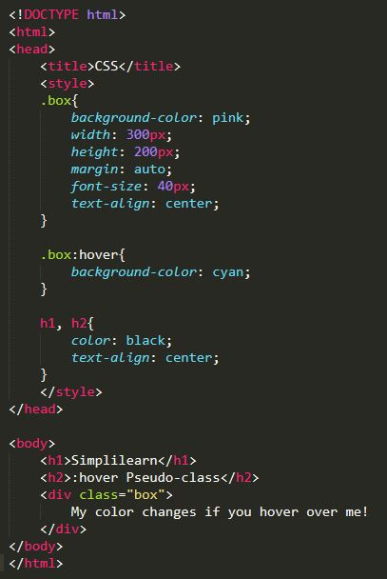
CSS Basics
1
Definition
CSS stands for Cascading Style Sheets.
2
Function
It's used to style HTML elements like colors, fonts, and layout.
3
Syntax
CSS uses selectors and properties to target and style specific HTML elements.
4
Examples
CSS selectors include class, ID, and tag selectors. CSS properties include font-size, color, and margin.

Slide 7
Combining HTML and CSS
CSS Linking
Link your CSS stylesheet to your HTML document using the link tag.
1
2
3
Separation of Concerns
Class and ID
HTML is used for content, while CSS is used for styling.
Target specific HTML elements with CSS using class and ID selectors.

Slide 8


LearnTube CareerNinja
A comprehensive career guidance website that offers students from all backgrounds the tools and resources needed to plan their future career paths.

Slide 9

Aim and Objectives
Aim:
Create a functional and visually appealing website using HTML and CSS that effectively presents the project's content and purpose.
Objectives:
Develop a responsive layout ensuring optimal viewing across various devices.
Apply consistent and attractive styling to enhance user experience and engagement.
Structure content with semantic HTML for improved accessibility and SEO.
Implement user-friendly navigation and interactive elements to facilitate easy exploration.
Document the development process to provide insights and reference for future projects.

Slide 10

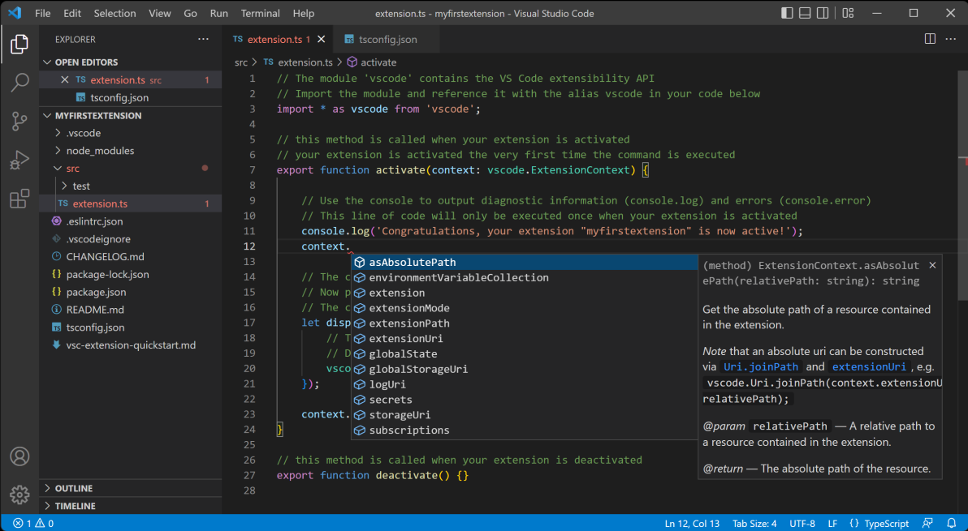
Hardware and Software Requirements
Minimum i3 processor
256 gb hard drive
4gb ram
Visual Studio Code/Notepad
Browser(Chrome)

Slide 11
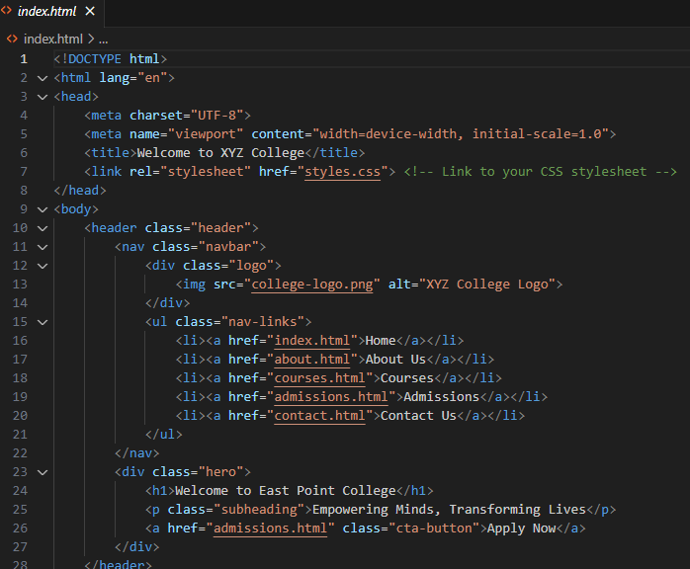
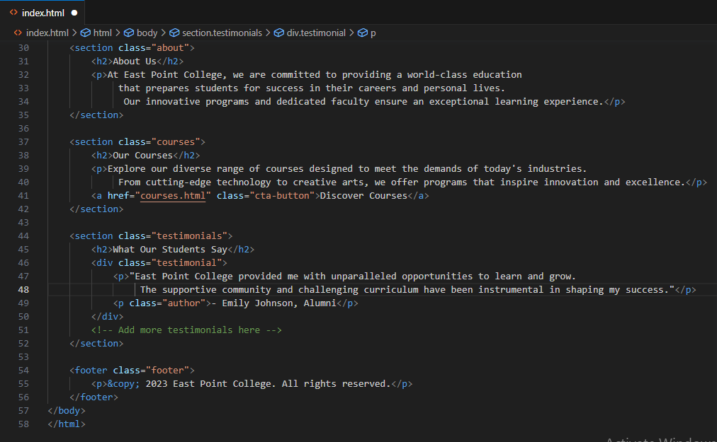
Implementation

Slide 12
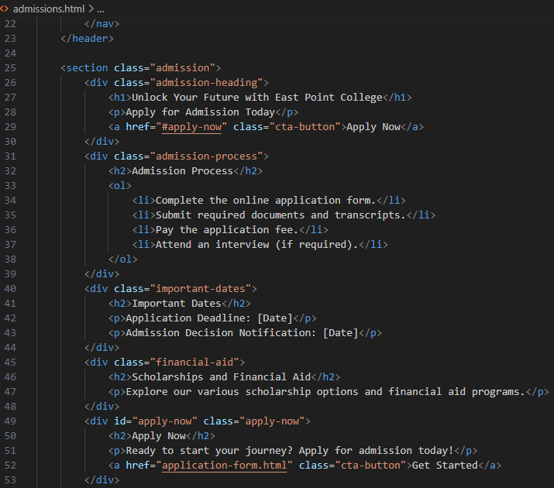
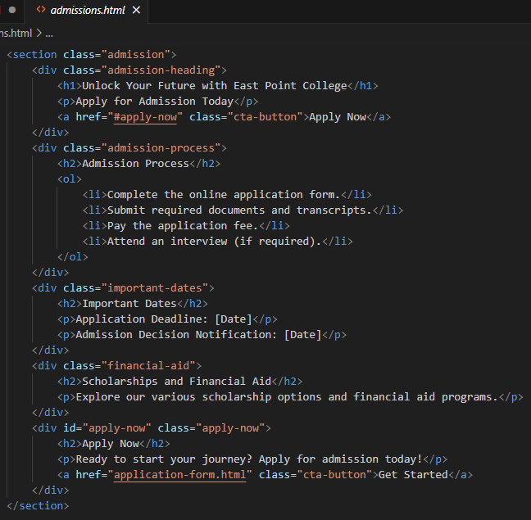

Slide 13
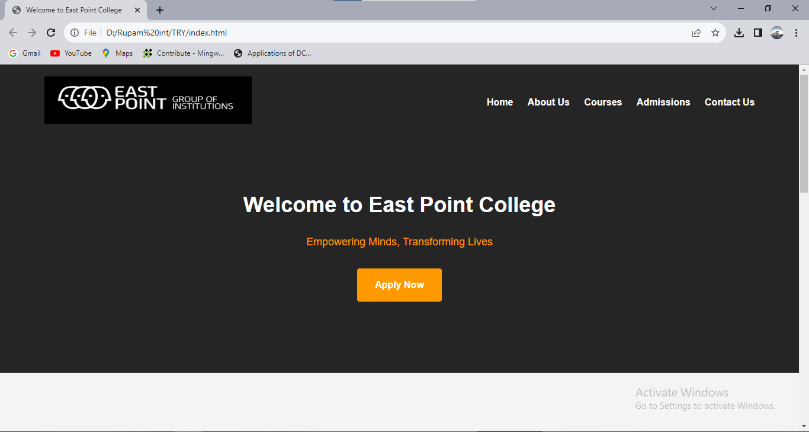
Project Outputs

Slide 14
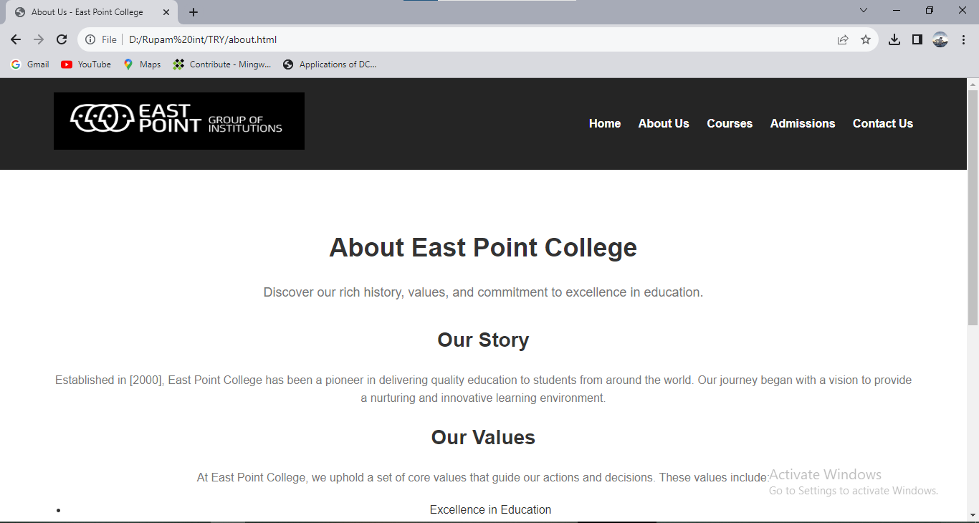
About Page:

Slide 15
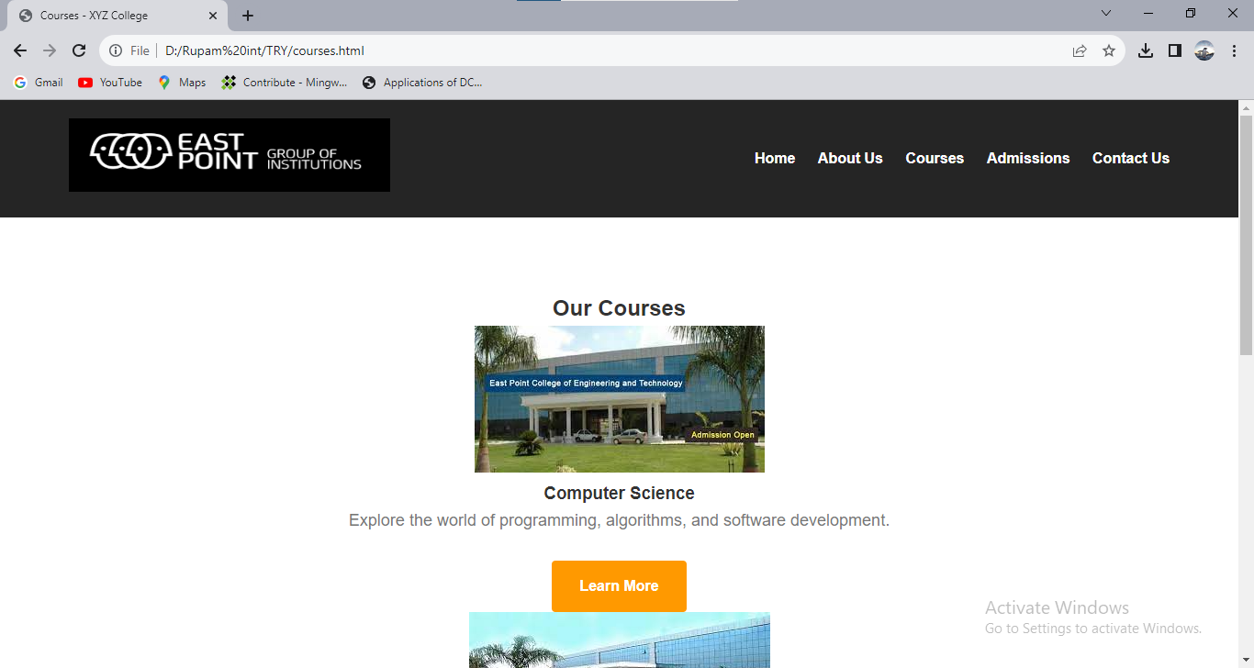
Courses Page

Slide 16
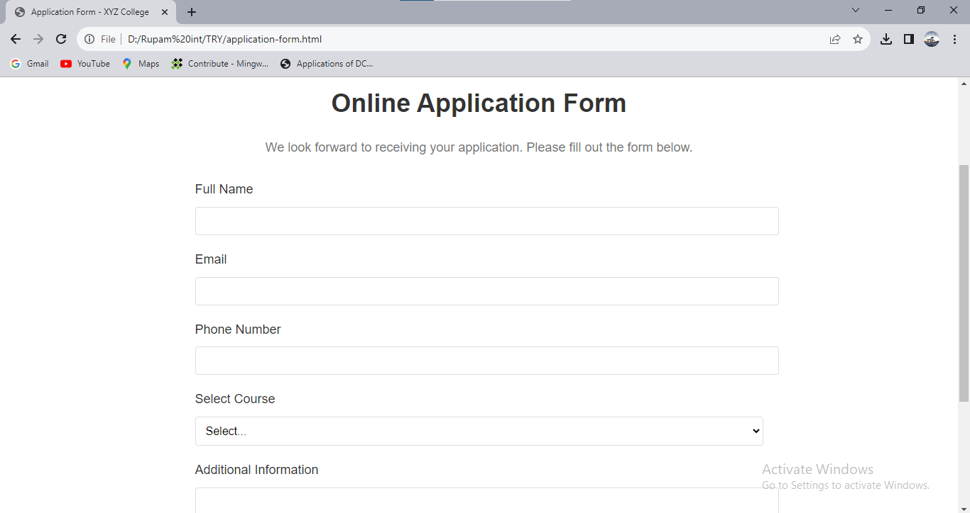
Application Form:

Slide 17
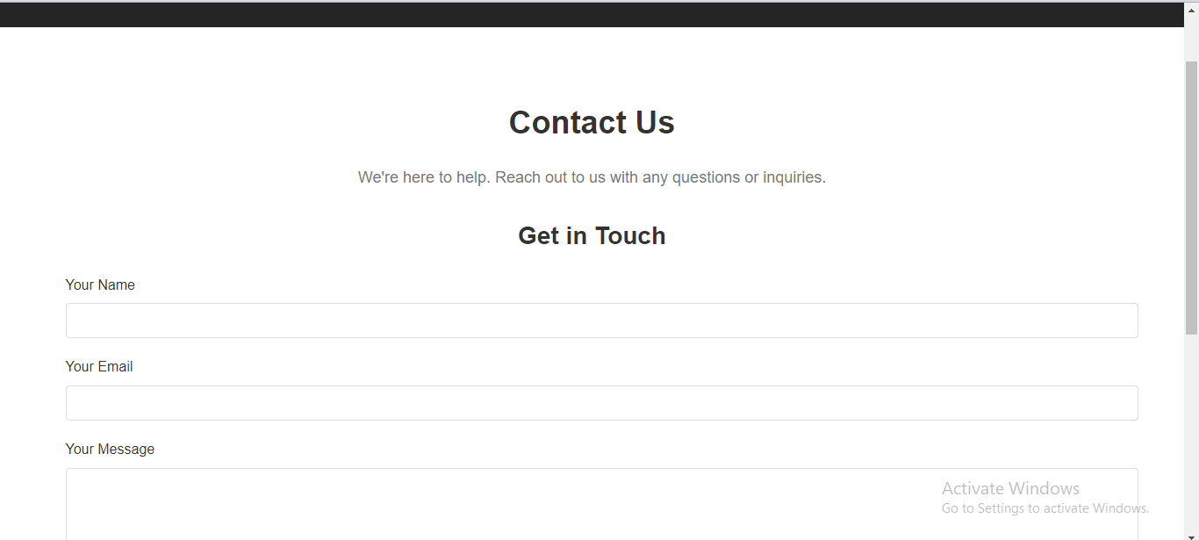
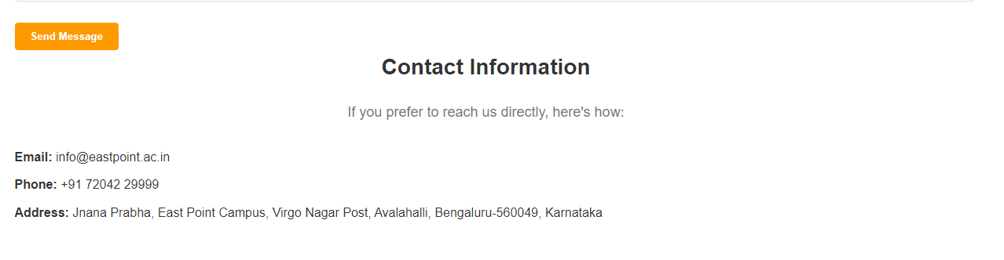
Contact Page:

Slide 18
Conclusion
On implementing this project , I learnt the technology how to made a web page structure using HTML and CSS.
The aim of this project was to create a web site of a college named East Point College, where there are 5 pages named home page, about us page, courses page, admission page, and contact us page.
Our project to create a website using HTML and CSS has been successfully executed. Through meticulous design and coding, we have crafted a visually appealing and user-friendly platform that effectively communicates our intended content.
The combination of HTML's structural flexibility and CSS's styling prowess allowed us to achieve a seamless and engaging user experience. Our commitment to responsive design ensures optimal functionality across various devices, catering to a wider audience.
With the completion of this project, we have not only honed our coding skills but also gained a deeper understanding of web development principles. Moving forward, we remain enthusiastic about refining and expanding our website, embracing the ever-evolving landscape of technology and design.

Slide 19
References
MDN Web Docs - HTML: A comprehensive resource by Mozilla Developer Network (MDN) that covers HTML elements, attributes, and usage. https://developer.mozilla.org/en-US/docs/Web/HTML
MDN Web Docs - CSS: An in-depth guide by MDN on Cascading Style Sheets (CSS) properties, selectors, and techniques for styling web content. https://developer.mozilla.org/en-US/docs/Web/CSS
W3Schools - HTML Tutorial: A beginner-friendly tutorial that covers HTML basics, tags, and attributes, along with interactive examples. https://www.w3schools.com/html/
W3Schools - CSS Tutorial: A step-by-step guide on CSS styling, selectors, and responsive design, accompanied by hands-on examples. https://www.w3schools.com/css/
CSS-Tricks: A website with a wealth of articles, tutorials, and resources related to CSS, including advanced techniques, layouts, and animations. https://css-tricks.com/
A Book Apart - "HTML & CSS: Design and Build Websites" by Jon Duckett: This well-regarded book provides a comprehensive introduction to HTML and CSS, emphasizing design principles and best practices. https://abookapart.com/products/html-css

Slide 20
THANK YOU

